Slide 1

Phasor Estimation Analysis
Time-Domain vs. Frequency-Domain Approaches
Haron Akram Ahmed Mohammed
Supervisor: Valgerður Jónsdóttir
KTH Royal Institute of Technology | Electrical Engineering
Notes:
Hi everyone, my name is Akram Ahmed and I’ll be presenting my frequency-domain phasor estimation algorithm which is a refinement made on an existing time-domain estimation algorithm. I’d like to extend a quick thank you to my supervisor, Vala, for her guidance throughout this thesis.
We will walk through an open-source Phasor Measurement Unit, and how I refined its digital signal processing engine to make it more robust and compatible for modern grid emergencies.

Slide 2
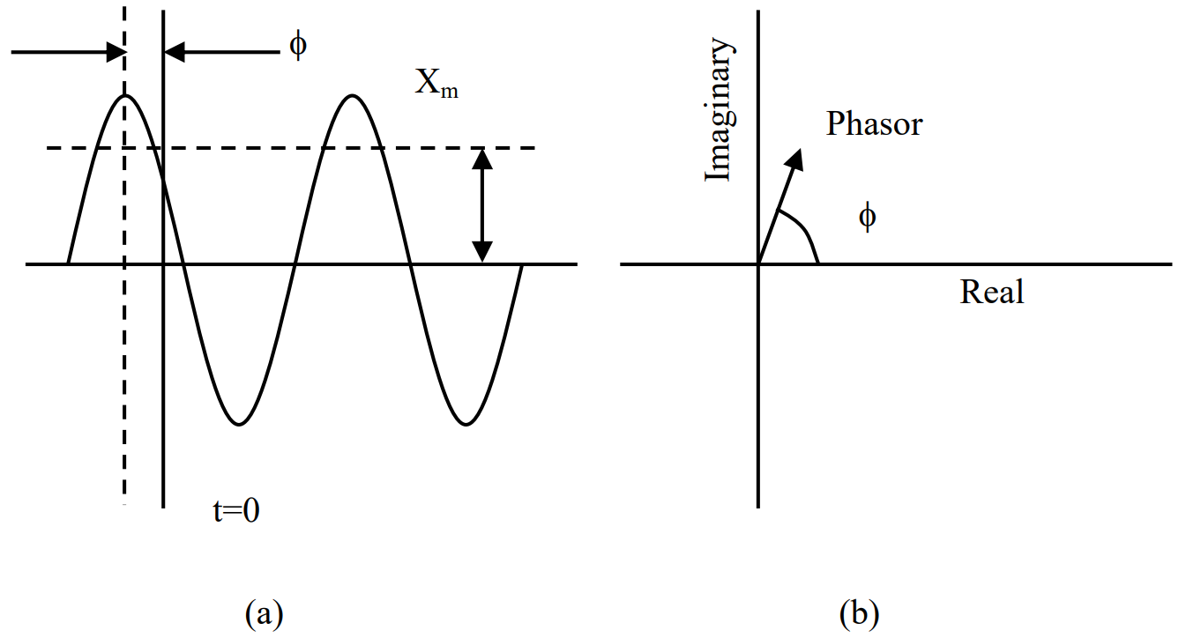

The Challenge: Low-Inertia Grids
The Renewable Shift
Massive integration of converter-based wind and solar energy.
Traditional synchronous generators are being displaced.
Mechanical Inertia is heavily reduced.
The Threat: Frequency fluctuations happen much faster and more violently, requiring microsecond response times.
Fig. 1. A power system signal as (a) a time-domain waveform and (b) a complex synchrophasor. The magnitude Xm is the RMS value, and the phase angle ϕ is relative to t=0.
Notes:
To understand why this algorithmic refinement was necessary, we have to look at the state of our current power grid. As we integrate massive amounts of renewable energy like wind and solar, we are inadvertently displacing traditional synchronous generators. This means the grid is losing its mechanical inertia which is the physical momentum that keeps our frequency stable at 50 Hz.
Because of this, frequency fluctuations now happen much faster and more violently. Traditional SCADA systems, which update every 2 to 4 seconds are too slow to catch up with these transients. Therefore we need Phasor Measurement Units, or PMUs.
Their job is to extract a Synchrophasor which is a mathematical representation of the waveform that gives us the exact amplitude, frequency, and phase angle.

Slide 3
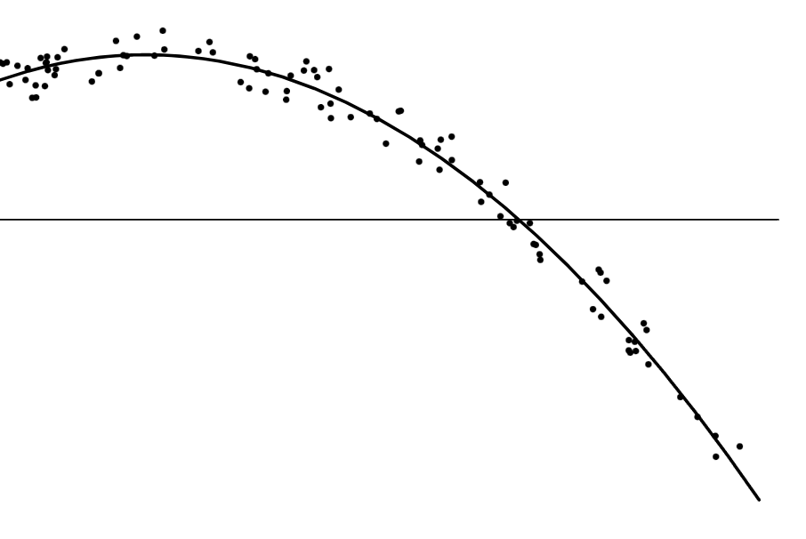
The Least Squares Method (LSM)
LSM is a time-domain algorithm that estimates the phasor by finding a mathematical curve that best fits the incoming voltage samples.
The Fatal Flaw of LSM
The existing algorithm curve-fits the incoming data to a rigid 50 Hz template matrix
Problem: During a fault, the grid frequency is NOT 50 Hz.
The matrix mismatch causes severe calculation ripples and massive estimation errors.
Fig. 2. Visualization of the LSM minimizing the vertical errors between the raw data points and the estimated mathematical template.
Notes:
However, to calculate these phasors, the existing PMU used a time-domain algorithm called the Least Squares Method, or LSM. As seen in the figure, LSM works by taking the incoming data points and minimizing the errors to fit a predefined mathematical curve.
Because of this, the LSM is programmed to curve-fit the data to a 50 Hz sine wave. It assumes the grid is always at nominal frequency. During a grid fault, the real frequency is not 50 Hz. When the real data hits that template, we get a matrix mismatch. The algorithm struggles to fit the data, and massive estimation errors occur right when we need accurate data the most.

Slide 4

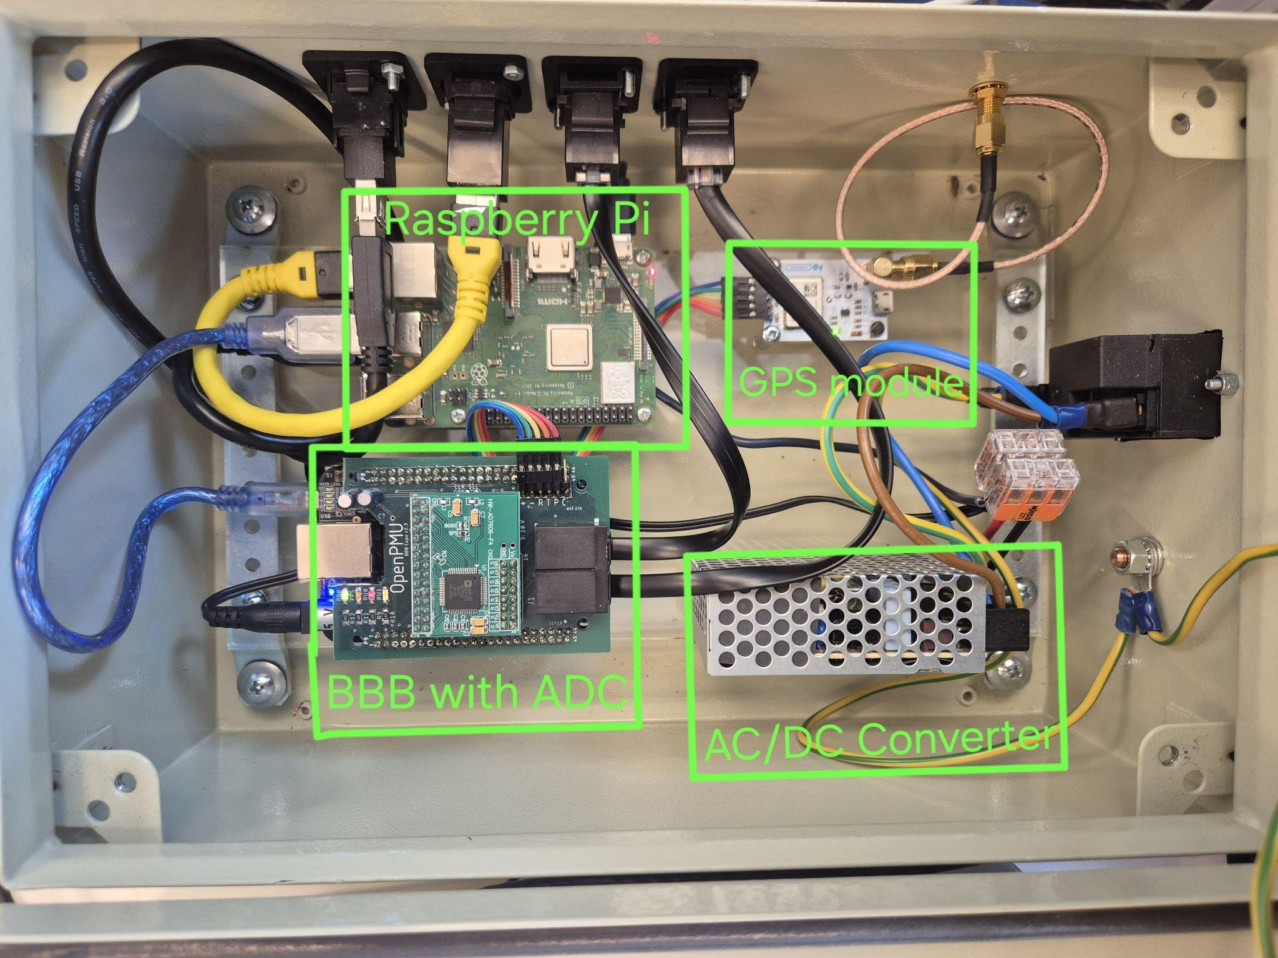
Project Scope and Success Criteria
Algorithm
Implement both LSM and the frequency domain e-IpDFT.
Deployment
Deploy both LSM and e-IpDFT simultaneously on a Raspberry Pi / BBB setup.
Validation
Must meet IEEE C37.118 P-Class (Protection) steady-state limits.
Fig. 3. Physical PMU prototype at KTH, featuring the BeagleBone Black (with custom ADC board), GPS module, AC/DC converter, and Raspberry Pi.
Notes:
This brings us to the core objective of my thesis. The goal is to replace the time-domain LSM with a highly adaptable frequency-domain algorithm known as the Enhanced Interpolated Discrete Fourier Transform, or e-IpDFT.
To ensure a fair comparison I deployed both algorithms on the same physical PMU, using a BeagleBone Black and Raspberry Pi. After implementation and rigorous testing, my new algorithm was validated against IEEE P-Class steady state limits which were used as the grading material.

Slide 5
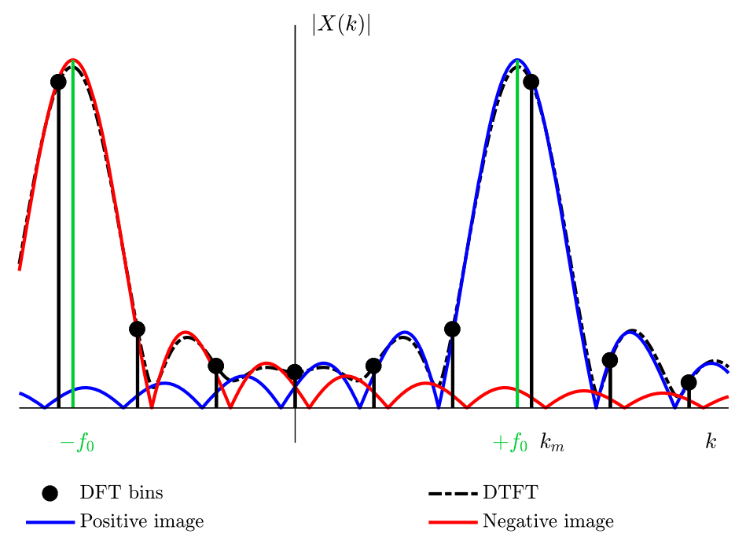
Proposed Solution: e-IpDFT
The e-IpDFT calculates the actual frequency peak using three steps:
Hanning Window: Tapers the signal edges to zero, heavily reducing spectral leakage.
Fractional Bin Offset: Interpolates between the two highest discrete frequency bins to find the exact off-nominal frequency.
Negative Image Compensation: Iteratively calculates and subtracts the interference caused by the negative frequency spectrum across the zero-axis.
Fig. 4. Continuous spectral leakage from the negative frequency image crosses the zero-axis, artificially corrupting the positive frequency bins.
Notes:
The e-IpDFT solves the 50 Hz template assumption by looking at the frequency spectrum to find where the actual energy peak is. It does this in three main steps.
First, it applies a Hanning Window to the raw samples. This forces the edges of our observation window to zero, which heavily reduces spectral leakage. Second, because the true grid frequency might fall between the discrete frequency bins, it calculates a fractional bin offset to estimate the exact off-nominal frequency. Finally, and most importantly, it performs Negative Image Compensation.
As seen in the figure, energy from the negative frequency spectrum bleeds across the zero-axis and corrupts the positive measurements. The e-IpDFT iteratively calculates and subtracts this interference to achieve extreme mathematical accuracy.

Slide 6
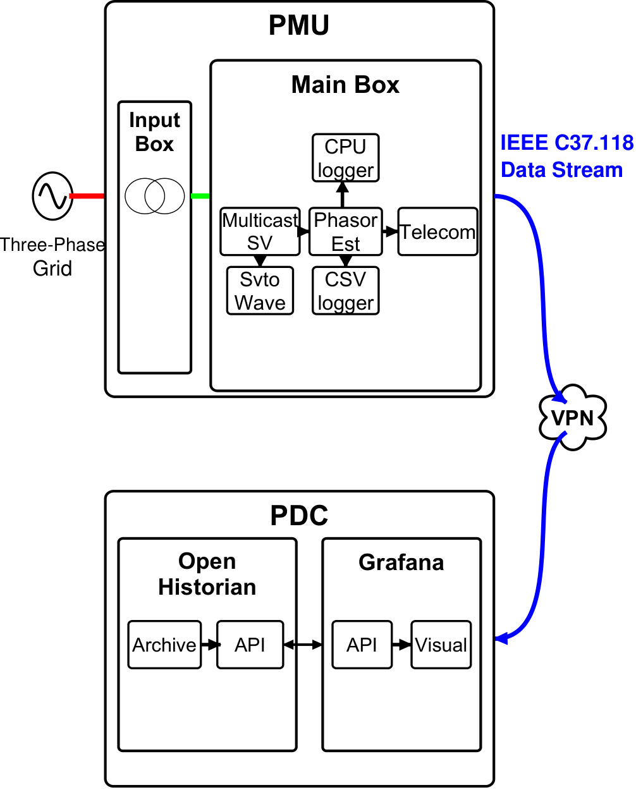
System Architecture: The Modular Pipeline
The Measurement Flow:
Independent scripts communicate over an internal multicast bus, allowing the math engine to be upgraded without breaking network logic.
Data Ingestion (MulticastSV): Ingests raw 10 kHz voltage samples from the BeagleBone hardware.
Core Processing (PhasorEst): Extracts the phasor. To handle the 10,000 Hz bottleneck, the heavy e-IpDFT math is executed here using a compiled C++ shared library.
Data Dispatch (Telecom): Packages the results into the IEEE C37.118 protocol and streams them over a secure VPN to the remote data concentrator.
Fig. 5. The OpenPMU modular software pipeline. Raw 10 kHz hardware samples are ingested, processed by the central PhasorEst engine, and packaged for secure transmission.
Notes:
To deploy this complex math, I had to work within the OpenPMU architecture. As shown in the diagram, this is a modular pipeline where independent scripts communicate over an internal multicast. First, 'MulticastSV' ingests the raw 10 kHz voltage samples from the hardware. Then, it goes to the core estimation module, 'PhasorEst'.
Python easily handles the LSM's simple matrix math but it would bottleneck and drop frames when running the heavy e-IpDFT. Therefore, I implemented a cross-language solution.
The e-IpDFT math was compiled into a C++ shared library, and then passed raw memory pointers directly from Python to C++.
Finally, the 'Telecom' module packages the results into the IEEE protocol and sends it over a secure VPN.

Slide 7
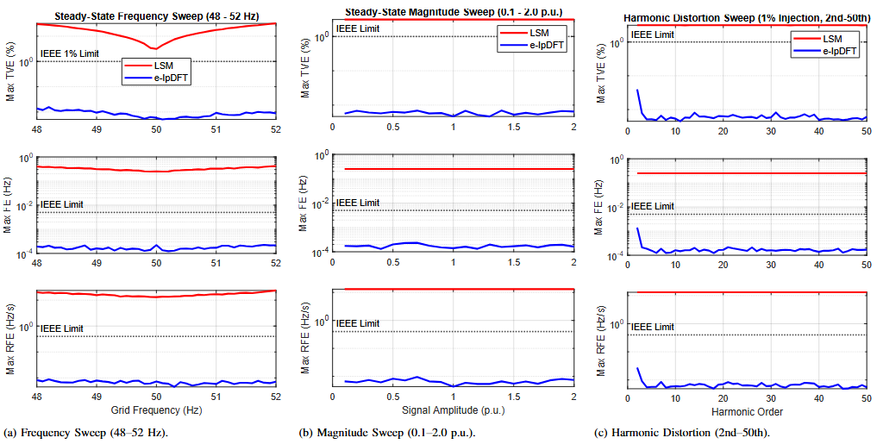
Simulation Results: IEEE Compliance
IEEE C37.118 Error Metrics
TVE: Total Vector Error (Complex phasor difference). Limit: 1.0%
FE: Frequency Error. Limit: 0.005 Hz
RFE: Rate-of-Change-of-Frequency Error. Limit: 0.4 Hz/s
Outcome: During 48-52 Hz sweeps, the LSM failed (TVE ~32%). The e-IpDFT remained highly compliant (TVE 0.016%).
Fig. 6. Steady-state compliance sweeps (logarithmic scale). e-IpDFT strictly adheres to IEEE limits across all tests, while LSM fails severely during frequency deviations.
Notes:
Before deploying it to the actual grid, both algorithms were subjected to rigorous MATLAB steady-state simulations to test for IEEE compliance. Note that the graphs on the screen use a logarithmic scale to capture the difference clearer.
Looking at the figures, the most notable results are the Total Vector Error or TVE during the frequency sweep from 48 to 52 Hz. TVE is the difference between the true synchrophasor and the estimated synchrophasor.
We can clearly see that LSM fails catastrophically, hitting nearly 32 percent error as it moves away from 50 Hertz. The e-IpDFT, however, dynamically tracks the frequency shift, maintaining a highly stable TVE of 0.016 percent. The e-IpDFT also remained well within the limits for Frequency Error and Rate-of-Change-of-Frequency Error.

Slide 8
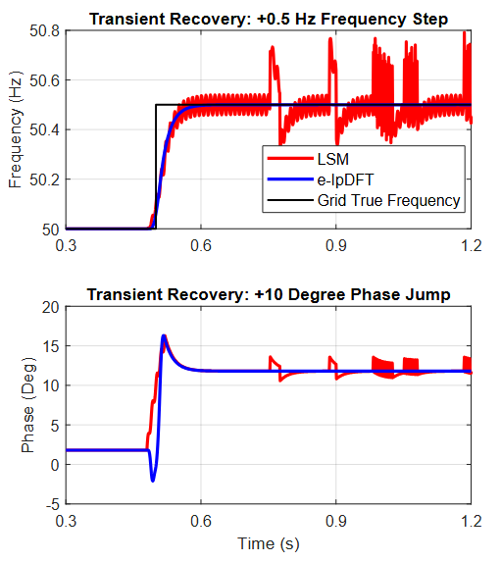
Transient Recovery Behavior
Disturbance Test
Test: +10° phase jump and +0.5 Hz frequency step.
Note: Instantaneous +0.5 Hz step is physically impossible due to generator inertia, but it exposes the underlying algorithm math.
LSM: Violent oscillations during recovery due to fixed-template mismatch.
e-IpDFT: Smooth transition and rapid settling to new grid state.
Fig. 7. Simulated response to instantaneous grid disturbances. The e-IpDFT handles mathematical shocks smoothly, exposing the rigid limitations of the LSM.
Notes:
I also subjected the algorithms to grid disturbances, specifically a phase jump and a frequency step. As illustrated in the figures, the LSM matrix oscillates violently as it tries to force the shifting data into its 50 Hz template. The adaptable e-IpDFT simply tracks the shift and settles smoothly.

Slide 9
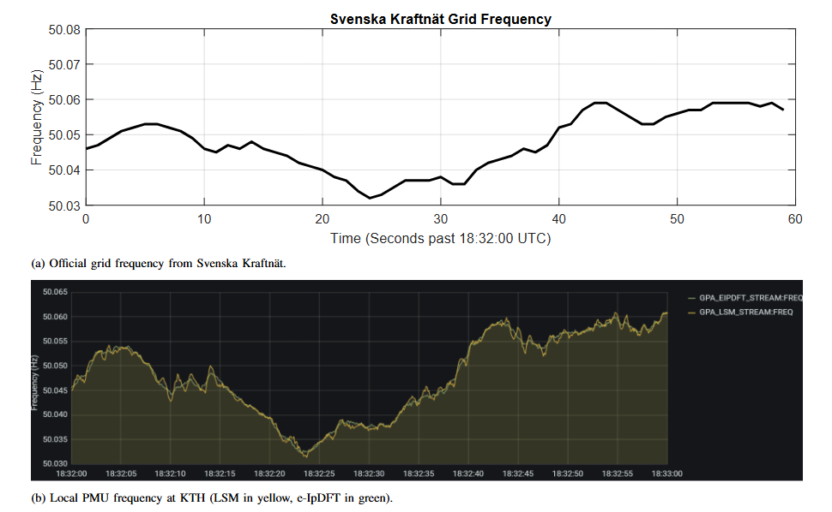
Live Tracking of the Grid
Fig. 8. Live frequency tracking comparison. (a) Official Svenska Kraftnät reference. (b) Local e-IpDFT estimation captured in the Grafana visualizer.
Notes:
With the math validated, I moved to live hardware testing on the grid. I benchmarked the PMU’s outputs against the official national frequency data published by Svenska Kraftnät's control room.
Because the Nordic power grid is highly stable, the real frequency stayed very close to 50 Hz during the observation window. As captured directly from the Grafana visualizer, the local e-IpDFT successfully tracked the exact same major trends as the official grid data, proving its accuracy in real-time.

Slide 10
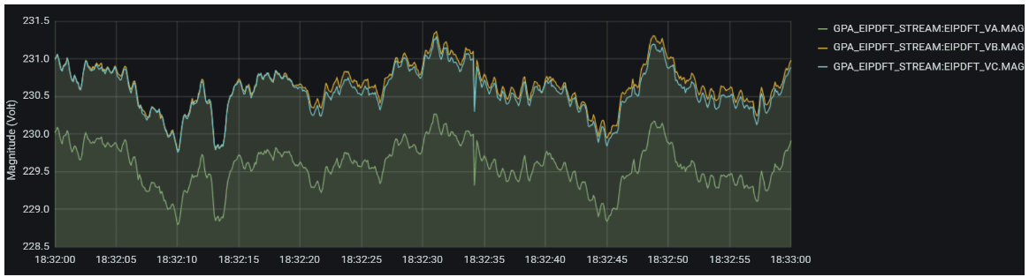

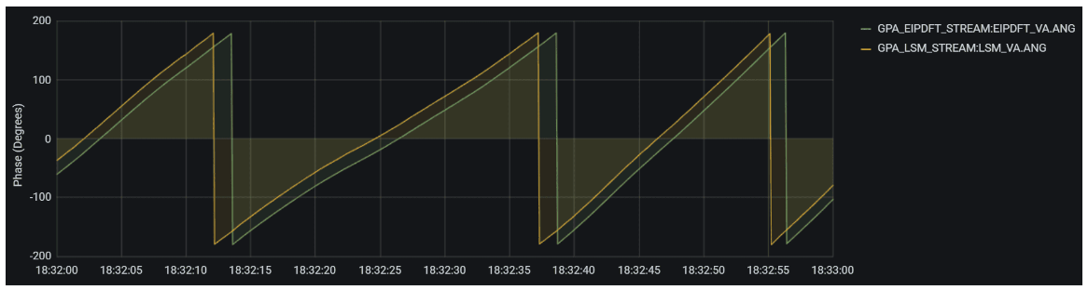
Identifying Hardware Realities
Voltage Imbalance
Consistent 1V variance on Phase A. Traced to analog component tolerances (resistors) on the expansion board.
The 2-Second Delay
Found in Grafana outputs. Believed to as a synchronization delay in cross-language buffer handoff, not a math failure.
Fig. 9. Real-time device diagnostics. The phase angle comparison reveals a 2-second synchronization delay, while the three-phase tracking demonstrates the operational stability of the C++ wrapper.
Notes:
Slide 10:
However, running algorithms on physical hardware always reveals real-world limitations. Looking at the phase angles, I noticed a consistent 2-second delay. I believe this is caused by the buffer handoff between Python and C++, meaning it's a software timing delay, not a math error.
In the three-phase tracking, Phase A consistently read 1 Volt lower than the others. With some rigorous troubleshooting I believe I traced this back to minor manufacturing tolerances in the analog resistors on the input board.

Slide 11
Conclusion
The LSM Limitation: The rigid 50 Hz template fails strict IEEE P-Class requirements, causing large oscillatory errors during grid frequency deviations.
Live Validation: Benchmarking confirmed the algorithm's operational stability, revealing that physical hardware constraints, not the mathematical engine, are now the primary system bottlenecks.
The e-IpDFT Success: Adapts to actual grid frequencies using a Hanning window and fractional bin offsets, maintaining extreme accuracy under off-nominal conditions.
Next Step:
Hardware Upgrades: Upgrade the analog-to-digital expansion board to resolve the 1V resistor tolerance issue, and integrate a stronger GPS module for indoor synchronization.
Notes:
In conclusion, the rigid 50 Hz template of the time-domain LSM fails strict IEEE P-Class requirements during grid fluctuations. By applying a Hanning window, fractional bin offsets, and negative image compensation, the e-IpDFT successfully adapts to the actual grid frequency and maintains extreme accuracy.
Future work could focus on upgrading the analog expansion board to resolve the resistor tolerances.
Once complete, we can deploy these upgraded PMUs geographically to capture long-term, wide-area fault data.

